Slide 1
MBA201
Module-2
HR Planning: Importance of HR Planning,
Manpower Planning to HR Planning,
Factors Affecting HR Planning,
Benefits of HR Planning, HRP Process,
Tools for Demand Forecasting, Attributes of an Effective HR Planning, Barriers to HR Planning, The Challenges for HR,
Process of Job Analysis, Job Description and Job Evaluation
Internal Mobility: Promotion, Demotion, Transfer.
External Mobility: Employee Attrition, Absenteeism, Retirement, Retrenchment, Layoff, Resignation

Slide 2
HRP
Human Resource Planning is also known as
manpower planning. Personnel management involves productive exploitation of manpower resources. Manpower management involves choosing the right personnel as and when the need arises. As aforesaid, it also involves upgrading qualitatively,

Slide 3
Manpower is defined as the total knowledge, skills, creative abilities and aptitudes of an organization's work force…the sum total of inherent abilities, acquired knowledge and skills represented by the talents and aptitudes of the employed persons

Slide 4

Quantitative, and
Qualtitative
Manpower planning has two major objectives:
1. Formulation of recruitment plans to avoid unexpected shortages etc., and
2. Identification of training needs to avoid skill shortages

Slide 5

To eliminate haphazard expansion of personnel.
The micro plan (section wide)
macro plan (organization wide)
2. To have declared and consensual personnel policy.
3. Personnel policy must be developed at the headquarters or comparable level.
4. Staffing section must be under the charge of a duly qualified and trained personnel officer.

Slide 6
5. Manpower planning should involve proper-mix of different categories of workers.
6. While formulating personnel policy, all possible internal as well as external resources should be explored for data collection.
7. Personnel department should lay down a clear policy and then supervise its implementation.
8. The personnel department must also design an effective system for evaluating individual and staff performance.

Slide 7
9. The personnel department must carry out researches into various aspects of personnel administration.
10. The gap between planning and implementation must be bridged if plans are to be successfully converted into reality.
11. Training programmes should be need-based, task-oriented and use practical simulations where trainees work and apply their skills.

Slide 8
12. There is need for role clarity to avoid overlapping and role ambiguity.
13. Manpower planning is a continuous, networked cyclical process requiring constant review and adjustments.

Slide 9

The process of systematically
reviewing HR requirements to ensure
that the required number of employees, with the required skills, are available when they are needed.

Slide 10


HRP or employment or personnel
planning is essentially the process of getting the right number of qualified people into the right job at the right time so that an organization can meet its objectives
Forward looking
In sync with organizational needs
In tune with corporate plans

Slide 11
HRP IMPORTANCE
1. The Reservoir of talent
2. Prepare people for future
3. Expand or contract
4. Cut costs
5. Succession planning
6.Proactive
7.Get qualified people at right time

Slide 12

Is essential to optimize human capital utilization
Is scientific in nature
Involves tracking supply of personnel to match with estimated demand
Has organization- wide impact. The result is improvement in all spheres of administration
Furthers employee motivation

Slide 13
Human resource planning avoids inter-personal tensions, role-conflicts and overlapping.
Cost cutting is applied through human resource planning.
It helps management forecast long-term manpower supply and demand.
A crucial factor in improving coverage and quality of services rendered by an organization is adequate number of personnel with task-oriented training.

Slide 14
Many organizations are either over-staffed or under-staffed as public sector units hardly practice manpower planning.
Manpower planning incorporates the idea of performance budgeting in that the emphasis in either case is on specifying objectives in measurable terms.
Manpower planning helps organizations develop uniformity and consistency in personnel policy, in consonance with socio- economic plan of the country

Slide 15

1. Objectives
2. Top Management Support
3. Employee skill inventory
4. HRIS
5. Coordinating

Slide 16

1. Forecasting demand for HR
a. External Challenges
Economic development
Political, legal, social and technological changes
Competition
b. Organizational decision
c. Workforce factors-retirement, termination, absence
d. Forecasting Techniques
Judgemental methods, Trend analysis. Mathematical model, Computer model
Workforce Analysis, Workload Analysis, Job analysis

Slide 17

d. Forecasting Techniques
Judgemental methods-
Bottom up forecasting
Top down forecasting,
Delphi technique,
Trend analysis,
Mathematical model- regression, optimization models, budget and planning
Computer model

Slide 18

2. Preparing Manpower Inventory (Supply forecast)
a. Internal labour supply-employee demography
b. Forecasting Technique-Staffing table, Markov analysis, Skills inventory, replacement charts
c. External labour supply

Slide 19

b. Forecasting Technique-
Staffing table- utilization
Markov analysis-future requirement
Skills inventory-openings with background
Replacement charts-who will replace whom

Slide 20

HRP Process
3. Determining Manpower Gaps
4. Formulating HR plans
1. Recruitment plan
2. Redeployment plan
3. Redundancy plan
4. Training plan
5. Productivity plan
6. Retention plan
7. Control points

Slide 21

The 4 stages of HR planning:
Forecasting demand for employees
Planning external supply
Analysing current employees
Planning internal supply

Slide 22
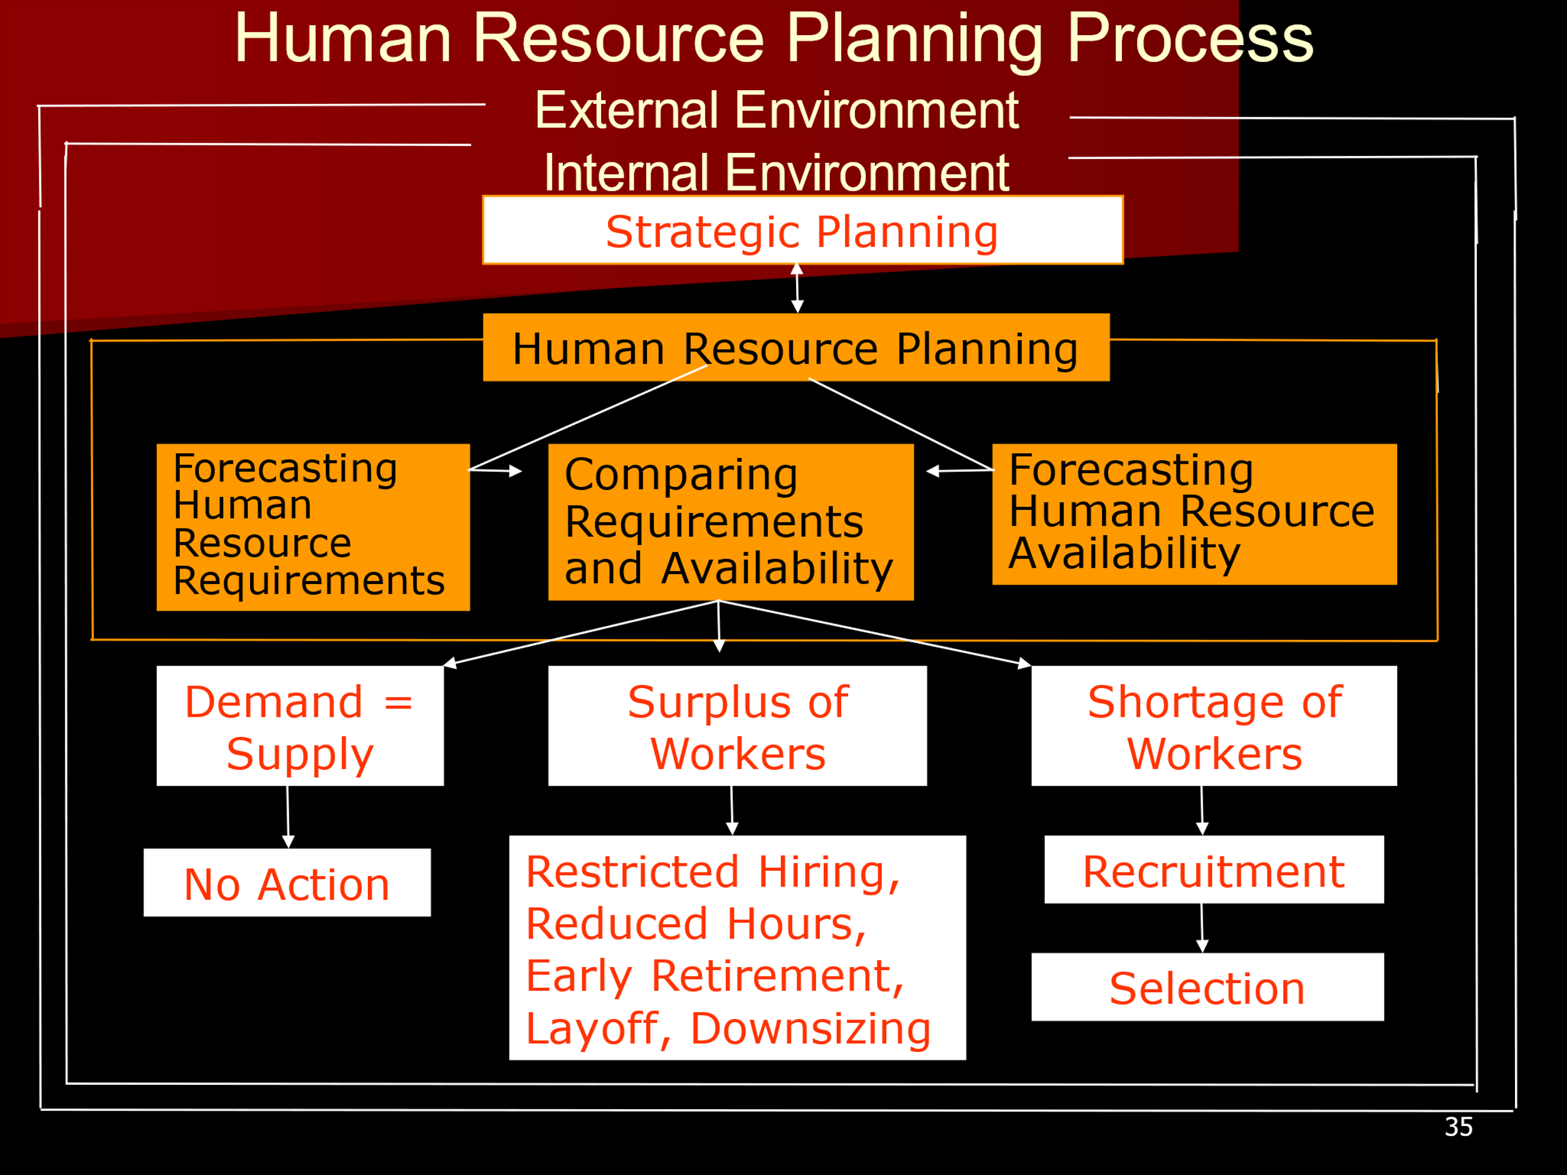

Slide 23

Manpower plan and objectives of the organization:
Assessment of the manpower situation:
Projection of manpower requirements:
Classification and interpretation of information:
Developing work standards and performance norms:

Slide 24
Anticipating manpower problems:
Costing Inventory:
Supply of Personnel:
Research Studies:
Manpower Planning and the Budget

Slide 25

Accuracy
Preparation
Support
Resistance
Numbers game

Slide 26

Tracking Time & Attendance.
Quiet Quitting.
Attracting High-Quality Talent.
Employee Engagement.
Employee Well-Being.
Measuring HR Effectiveness.
Compensation and Benefits.

Slide 27

Process of obtaining information about the job.
Wendell French (1997) defines job analysis as the systematic investigation and delineation of job content, including the physical circumstances in which a particular job is carried out and the qualifications needed to carry out job responsibilities.

Slide 28
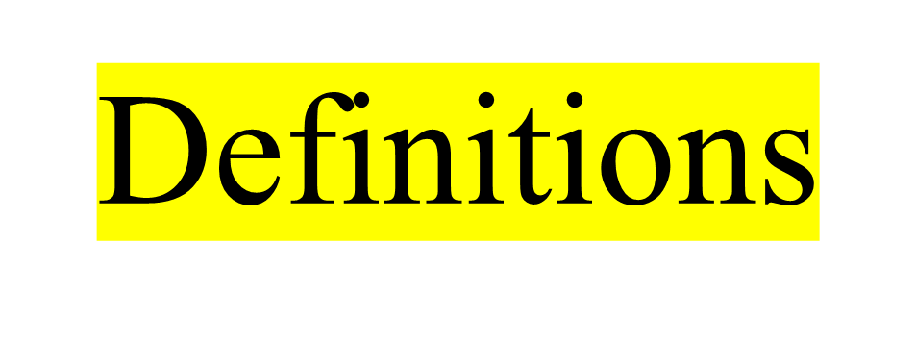
Job - Consists of a group of tasks that must be performed for an organization to achieve its goals for a price.
Position - Collection of tasks, duties and responsibilities performed by one person, there is a position for every individual in an organization.

Slide 29

Job analysis - Systematic process of determining the skills, duties, and knowledge required for performing jobs in an organization.
Process of obtaining information about job.
Job analysis is the process of studying and collecting information relating to the operations and responsibility of a specific job. Edwin Flippo

Slide 30

Job description – document providing information regarding tasks, duties, and responsibilities of job.
Job specification – minimum qualifications to perform a particular job.
Is a statement of the knowledge, skills, and abilities required of the person performing the job.

Slide 31
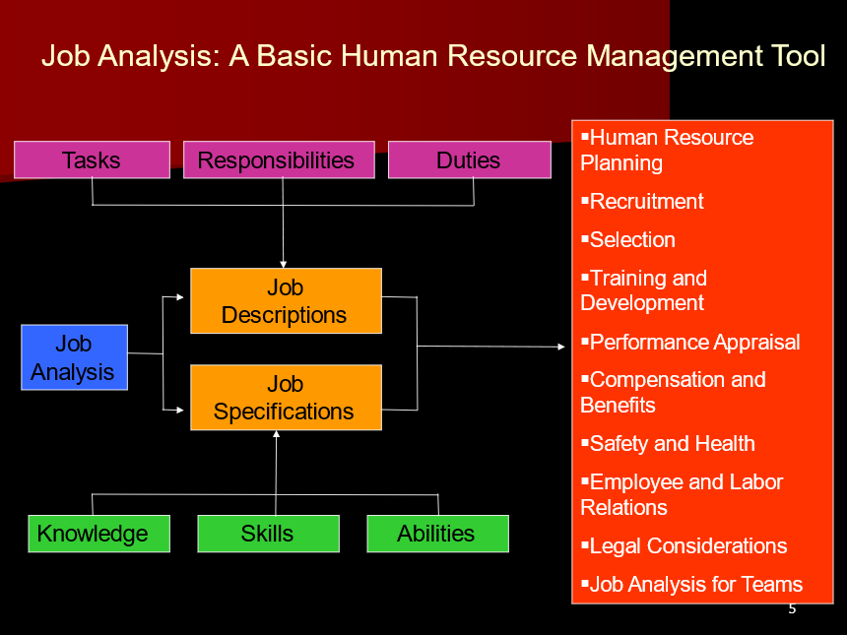

Slide 32

STEPS
Organizational Analysis
Selection of representative position to be analyzed
Collection of job analysis data
Preparation of job description
Preparation of job specification
Prepare a written document

Slide 33
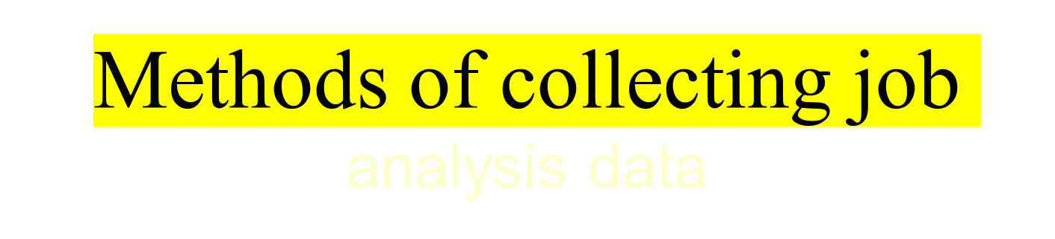
Job Performance
Personal Observation
Critical Incident
Interview
Panel of Experts
Dairy Methods
Questionnaire Method

Slide 34

Actual performance on job
Analyst receive contextual factors-physical hazards, social demand, emotional pressures and mental requirements.
Jobs that can be easily learned
Not for hazardous, and for jobs that require extensive training.

Slide 35

Analyst observes job performed, pace, working conditions
Analyst must observe average workers during average conditions
Analyst should observe without getting directly involved in job
Analyst must make note of the specific job needs and not the behaviors specific to particular workers
Analysts must make sure that he obtains a proper sample for generalization

Slide 36

Is a qualitative approach to JA used to obtain specific, behaviorally focused description of work or other activities
Describe several incidents based on past experience
Collected and analyzed and classified according to job areas
Effective and ineffective behaviors
Recorded after the event both routine and non routine, lengthy, dissimilar and JD is tough

Slide 37

Asking questions to both incumbents and supervisors in either an individual or group setting
Through job and observation
Workers know the specific duties and supervisors can relate to rest of organization
Trained interviewer and interview guidelines
Time consuming, costly, ambiguous questions
Distortion of answers

Slide 38

Senior job incumbents and superiors with extensive knowledge of the job
To get job analysts information, the analyst conducts an interview with the group
The interaction of the members during the interview can add insight and detail the analyst might not get from individual interviews

Slide 39

Diaries or logs of their daily job activities
Over a period of time will be able to record essential job characteristics
Timely and costly.

Slide 40

The positional Analysis Questionnaire (PAQ)
Management Position Description Questionnaire (MPDQ)
Functional Job Analysis (FJA)

Slide 41

Is a standardized questionnaire developed at Purdue University to quantitatively sample work oriented job elements
It focus on general work behavior instead of tasks
It contains 194 items divided into 6 major divisions
PAQ permits to group interrelated job elements into job dimensions

Slide 42

Information input
Mental processes
Physical activities
Relationship with other people
Job context
Other Job characteristics

Slide 43
Analyzing managerial job
The 274 items questionnaire contains 15 sections
It would take 2 and half hour to complete the questionnaire
In most cases respondents are asked to state how important each item is to the position

Slide 44

Is a worker oriented job analysis approach that attempts to describe the whole person on the job
It tries to examine the fundamental components of data, people and things
It is frequently used for government job
It is helpful in fixing wage rates

Slide 45

Identification of organization goal for FJA analysis – what should be
Identification of description of tasks –actions as physical, mental, interpersonal
In written format
Analysis of tasks using 7 scale
Develops performance standards
Development of training content

Slide 46


Questionnaires
  PAQ
  Functional job analysis
Observation
  Critical incident technique
Interviews
Employee recording
Combination of methods

Slide 47

JD is a written statement of what the job holder does, how it is done, under what conditions it is done and why it is done.
It describes what the job is all about, throwing light on job content, environment and conditions of employment
Defines purpose and scope of a job
To differentiate the job from other jobs and state its outer limits

Slide 48

Job title
Job summary
Job activities
Working conditions
Social environments

Slide 49

Summarizes the human characteristics needed for satisfactory job completion
It tries to describe the key qualifications, attributes of a person in terms of education, experience, skills, knowledge, and abilities to perform a job
Its a logical outgrowth of a job description
What kind of persons are needed

Slide 50

– Personal Attributes
Essential attributes: KSA
Desirable attributes: Qualification
Contra indicators: handicap to successful job performance

Slide 51

-ROLE set of expectations people have about the behavior of person in a position
Expected
Perceived
Enacted
STEPS
Objective of the departments and its functions
Key performance
Other role partners
Expression of JD

Slide 52

Manager
Incumbent
SME: Subject Matter Expert
Job analyst
DOT: Dictionary of occupational Titles
O*NET: Occupational Information Network

Slide 53

Importance of Recruitment,
Recruitment Policies,
Factors Influencing Recruitment, Recruitment Process, Sources,
Evaluation of Recruitment Process, Recruitment Strategy,
Future Trends in Recruitment;
Selection Process; Selection Tests;
Factors Influencing Selections.

Slide 54

It is a positive act since it attempts to encourage potential applicants to seek jobs in the firm.
It is not a single task; rather, it involves a series of planned activities.
It represents the first contact that an organization has with its potential employees.
It proposes to develop an applicant pool in the desired hiring ratio (the number of applicants for a job) to ensure an effective selection procedure..

Slide 55
It aims to discover and determine the sources of manpower to be utilized in tune with the strategic goals of the organization.
It intends to locate and reach out to the potential applicants, wherever they are, and offers an incentive to stimulate them to apply for the vacancies offered.
It is a function that calls for continued contact between the organization and the community as the latter makes the requisite human resources available to the former.

Slide 56

It is the process of attracting capable applicants for employment.
The process begins when new recruits are sought and ends when their applications are submitted. The result is a pool of applicants from which new employees are selected.
Recruitment is a process of searching for prospective employees and stimulating them to apply for jobs in the organization.

Slide 57

In the words of Flippo, “Recruitment is the process of searching for prospective employees and stimulating and encouraging them to apply for jobs in the organisation.
According to Dale Yoder, “Recruitment is a process to discover the sources of manpower to meet the requirement of the staffing schedule and to employ effective measures for attracting that manpower in adequate numbers to facilitate effective selection of an efficient working force.

Slide 58
Prospecting theory: Locating and encouraging potential applicants to apply for existing or anticipated job openings.
Recruiting large number of qualified applicants ready to take up job if offered.
Offering enough information to unqualified persons to self-select themselves out.
Creating positive image of the firm.
- Fit between organizational recruitment effort and a candidates job search effort.

Slide 59

Recruitment policy is the guiding principle that governs the HR practices relating to recruitment. It provides a broad framework for the HR department to choose its priorities relating to recruitment.
A methodical recruitment policy can ensure the availability of suitable persons at the appropriate time with the least disturbance to the production schedule

Slide 60

A good recruitment policy should be in conformity with the relevant public policy and legislations.
It should supplement the HR policies of the organization. In other words, it must not contravene the provisions of the general personnel policies.
It must display enough dynamism and progressiveness in its approach to attract the best talents for the organization.

Slide 61
It must constantly strive to make the necessary human resources available to match the skills requirement of the organization.
It should ensure equal employment opportunities for all sections of the society.

Slide 62

Retirement
Death
Resignation
Disability
Dismissal

Slide 63

Internal factors
Company’s Pay package
Quality of work life
Organizational culture
Career planning and growth
Role of trade unions
Cost of recruitment
Company size

Slide 64

Company’s products/services
Geographical spread of company’s operations
Company’s growth rate
Company’s name and fame
HR policy of the organization
Nature of the job
Reputation of the firm
Conventional wisdom

Slide 65
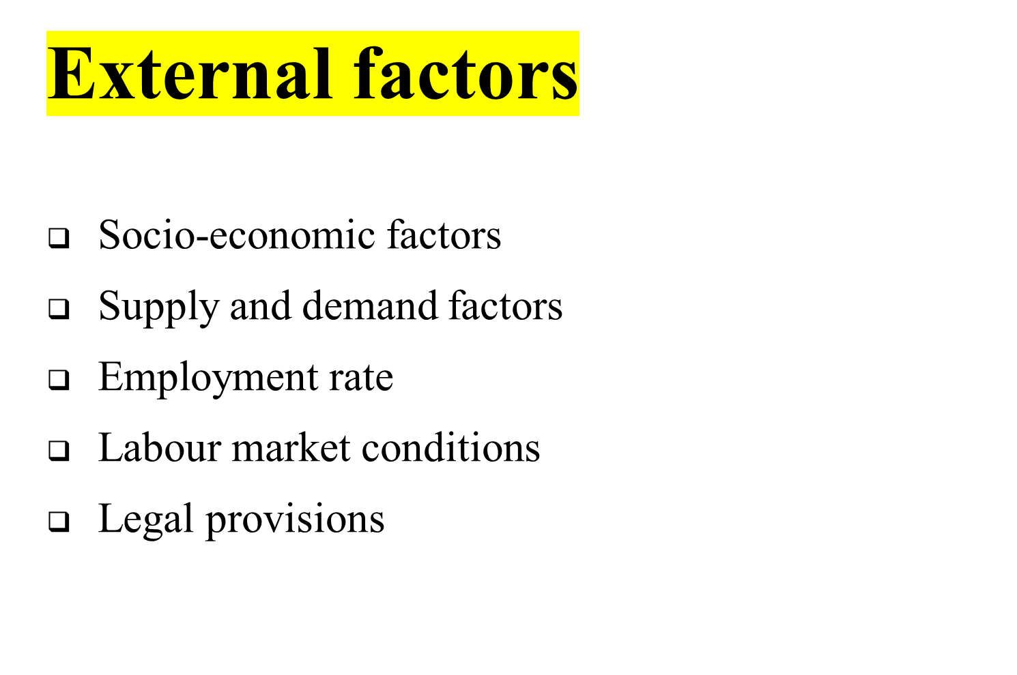

Slide 66

Human Resources Planning
Evaluation of the Sources of Recruitment
Implementation of Recruitment Methods and Strategies
Feedback and Control

Slide 67

Internal
  Present, Permanent employees
  Present, Temp/ Casual
  Retrenched / Retired
  Dependents of diseased , disabled , retired and present employees

Slide 68

Merits
1. Economical
2. Suitable
3. Reliable
4. Satisfying
Demerits
1. Limited choice
2. Inbreeding
3. Inefficiency
4. Bone of contention

Slide 69
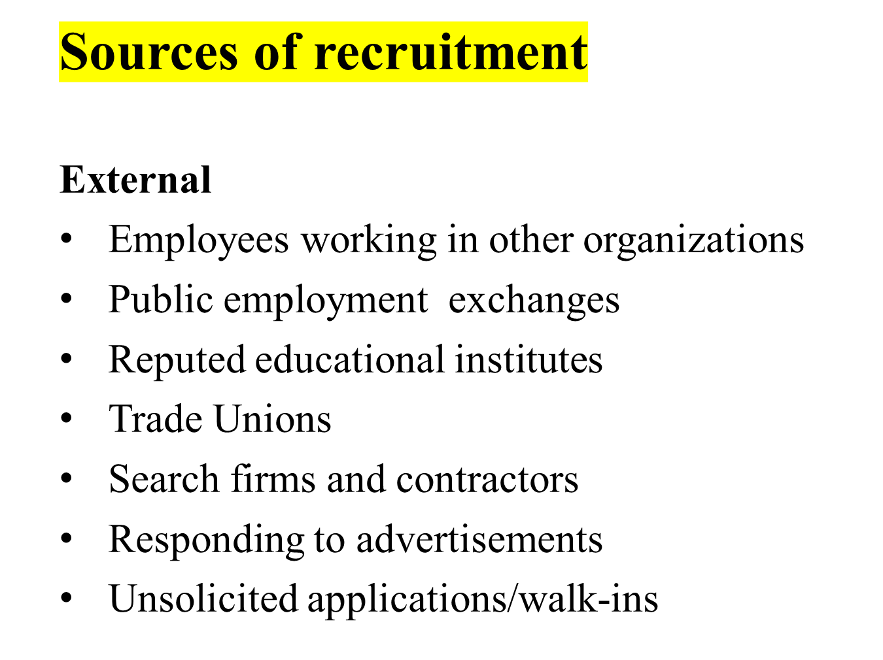

Slide 70


Slide 71

Merits
1. Wide choice
2. Injection of fresh blood
3. Motivational force
4. Long term benefits
Demerits
1. Expensive
2. Time consuming
3.Demotivating
4. Uncertainty

Slide 72

Internal Methods
1. Promotions and Transfers
2. Job Postings and Job Bidding
3. Employee Referrals
4. Employee Enlistment

Slide 73

Direct Methods
1.Campus Recruitment
- shortlist campuses
- Choose recruiting team carefully
- Pay smartly and not highly
- Present a clear image
- Do not oversell yourself
- Get in early
- Not everyone fits the bill

Slide 74

Indirect Methods
1.Newspaper ads
- Evaluate the pros and cons
- Right medium to get right stuff
- Lot of creativity entice people
2. Television and radio ads

Slide 75

Third party Methods
1. Private employment search firms
2. Employment exchanges
3. Gate hiring and Contractors
4. Unsolicited applicants/ walk-ins
5. Internet recruiting

Slide 76

1. Identify vacancy
2. job description and person specification
3. Advertising the vacancies
4. Managing the response
5. Short-listing
6. Arranging interviews
7. Conducting interview and decision making

Slide 77
1. Recruitment Planning
2. Recruitment Strategy
3. Searching the Right Candidates
4. Screening/Shortlisting
5. Evaluation and Control

Slide 78

The effectiveness and the validity of the process and methods are assessed
Salaries to the Recruiters
Advertisements cost and other costs incurred in recruitment methods, i.e., agency fees.
Administrative expenses and Recruitment overheads
Overtime and Outstanding costs, while the vacancies remain unfilled.
Cost incurred in recruiting suitable candidates for the final selection process
Time spent by the Management and the Professionals in preparing job description, job specifications, and conducting interviews.

Slide 79
Cost, Time, Flexibility, Quality
Time Lapse Data
Yield Ratio’s

Slide 80

While preparing a recruitment strategy, the HR team considers the following points:
Make or buy employees
Types of recruitment
Geographical area
Recruitment sources

Slide 81
The steps involved in developing a recruitment strategy include:
Setting up a board team
Analyzing HR strategy
Collection of available data
Analyzing the collected data
Setting the recruitment strategy

Slide 82

Outsourcing
Poaching/Raiding
E-Recruitment

Slide 83

To choose
Selection is the process of picking individuals who have relevant qualification to fill jobs in an organization.
The basic purpose is to choose the individual who can most successfully performs the job, from the pool of qualified candidates

Slide 84

Selection, as the name implies, involves picking and hiring a few people from the total number of candidates applying for the sales job.
Selection is done by comparing the requirements of a job with the applicant’s qualifications.
The following are, some common steps in any selection process:

Slide 85
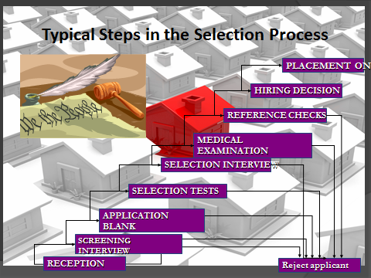

Slide 86

Reception: A Company is known by people it employs
KSA
Creating a impression
Courteous, Tactful, honesty, clearly.
Meet HR

Slide 87

The purpose of preliminary interviews is basically to eliminate unqualified applications based on information supplied in application forms.
• The basic objective is to reject misfits. On the other hands preliminary interviews is often called a courtesy interview and is a good public relations exercise.
• Courtesy interview-screen out obvious misfit

Slide 88

Collect information on various aspects of the applicants academic, social, demographic, work related background and reference
Personal data
Extracurricular activities
Marital data references
Physical data
Educational data
Employment data

Slide 89

Job seekers who pass the preliminary interviews are called for tests.
There are various types of tests conducted depending upon the jobs and the company.
A test is a standardized, objective measure of a persons behaviour, performance or attitude

Slide 90

Intelligence test, Aptitude Tests,
Personality Tests,(Projective tests, Interest tests, Preference tests),
Achievement tests, Simulation tests,
Assessment center and Ability Tests
and are conducted to judge how well an individual can perform tasks related to the job.
Besides this there are some other tests also like
Interest Tests (activity preferences), Graphology Test (Handwriting),
Medical Tests, Psychometric Tests, Polygraph, Integrity test, etc.

Slide 91

The next step in selection is employment interview. Here interview is a formal and in-depth conversation between applicant’s acceptability.
It is considered to be an excellent selection device. Interviews can be One-to-One, Panel Interview, or Sequential Interviews. Besides there can be Structured and Unstructured interviews, Behavioral Interviews, Stress Interviews. \
Types of Interview
The non directive interview, The directive or structured interview
The situational interview, The behavioral interview
Stress interview, Panel interview

Slide 92

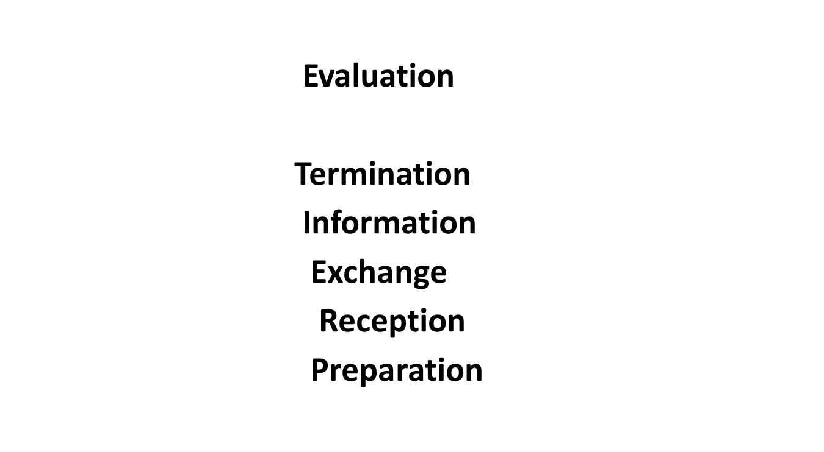

Slide 93

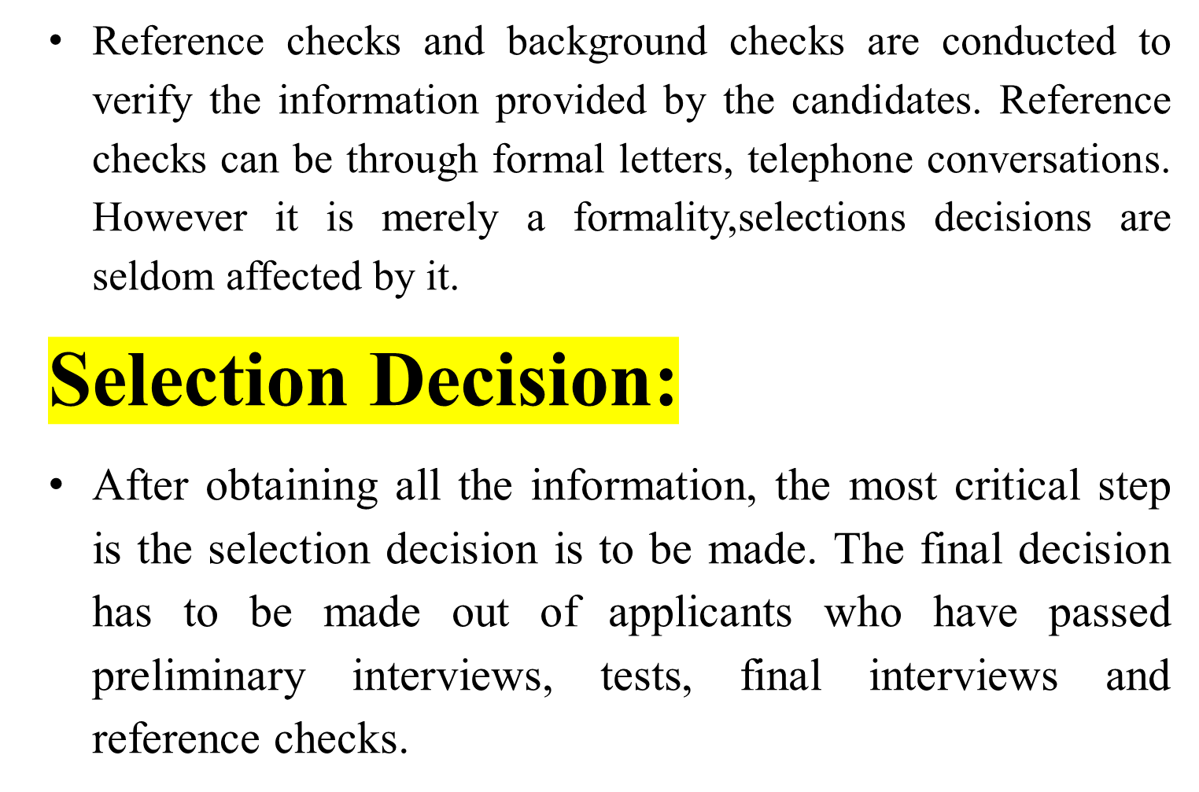

Slide 94

True positive
True negative
False positive error
False negative error
False positive error

Slide 95

Cost incurred while the person is employed, and this is the result of production or profit losses, damaged company reputation, accidents due to negligence, absenteeism and the like.
Costs associated with the training, transfer or terminating the services of the employee.
Costs of replacing generally the more important the job, the greater the cost of the selection.

Slide 96

1. In this type an applicant who would have succeeded is rejected because of predicted failure.
2. Cost difficult to estimate
Physical Examination: After the selection decision is made, the candidate is required to undergo a physical fitness test. A job offer is often contingent upon the candidate passing the physical examination.
Job Offer: The next step in selection process is job offer to those applicants who have crossed all the previous hurdles. It is made by way of letter of appointment.
Contract of Employment: After the job offer is made and candidates accept the offer, certain documents need to be executed by the employer and the candidate. Here is a need to prepare a formal contract of employment, containing written contractual terms of employment etc.

Slide 97

Whether the applicant is medically suitable for the specific job or not.
Whether the applicant has health problems or psychological attitudes likely to interfere with work efficiency or future attendance.
Whether the applicant suffers from bad health which should be corrected before he can work satisfactorily.
Whether the applicant’s physical measurements are in accordance with job requirements or not.

Slide 98
It shortlists the candidates by matching the candidate’s qualifications, skills, etc with those of skills and the right competencies inbuilt in the software
It also prepares interview schedules and communicates the same to the candidates
It streamlines the entire recruitment process for a given time and unlimited job recruitments
The number of people required for handling of applications are reduced drastically

Slide 99

1. Phone call and further clarification
2. Letter of intent
3. Completing employment forms
4. Protocols may be available for intetested individuals
5. Number of candidates
6. Names, surenames and adresses of 5 top candidates
7. Recruitment and selection criteria
8. Justification of the decision

Slide 100
Reception
Screening Interview
Application Blank-- Weighted Application Blanks
1. Selection Testing
2. Intelligence tests
3. Aptitude tests
4. Personality tests-projective tests, Interest tests, Preference tests
4. Achievement tests
5. Simulation tests
6. Assessment centre
a. The in-basket
b. The leaderless group discussion

Slide 101
b. The leaderless group discussion
c. Business games
d. Individual presentation
e. Structured Interview
Evaluation of Assessment centre
7. Graphology tests
8. Polygraph tests ( Lie- detector)
9. Integrity tests
Selection Interview
Medical examination
Reference checks
Hiring Decision

Slide 102

